Slide 1
Future Of The Web
By, Zain Ul Abideen Baloch
From Cloud to Edge Using Server Side Components.
React 18 Next JS 13

Slide 2
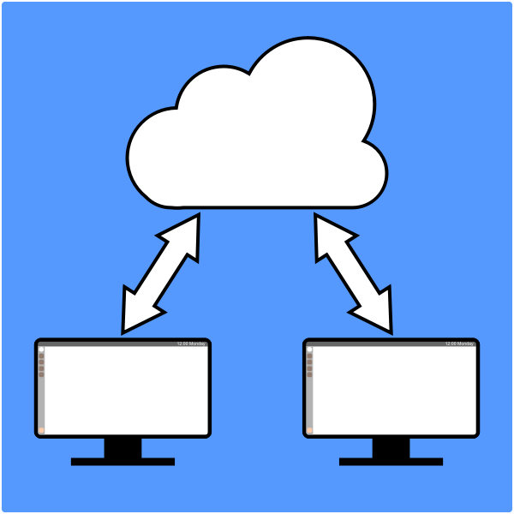
What is Cloud Computing?
Cloud computing was a revolutionary change. It helped the user store unlimited data and that too not in their devices but the servers provided.
Now you do not need external hard disk or put money on expensive hardwares, including regular maintenance cost that you will be bearing. Including the fact that you do not know if you will be using the whole thing or part of it.
What if it you do not have to do any of this, not buy expensive hardware or concerned about its maintenance, and pay for only used proportion? That too at real minimal cost.

Slide 3
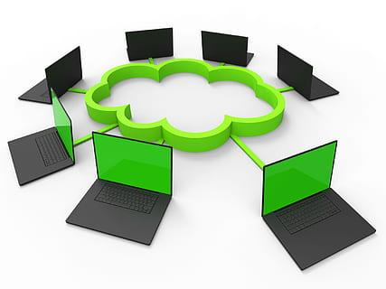
Examples of Cloud Computing!
o Microsoft Azure
o AWS
o Google Cloud
o IBM Cloud
o i Cloud etc

Slide 4
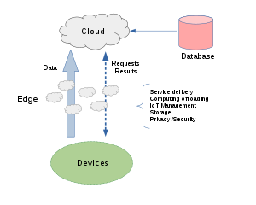
What is Edge Computing?
Edge Computing is the extension of Cloud Computing.
It solves a major issue of delay and covers the communication gap between server and the client.
Edge computing is fixed with the local device rather than the server & gives Real Time response.

Slide 5
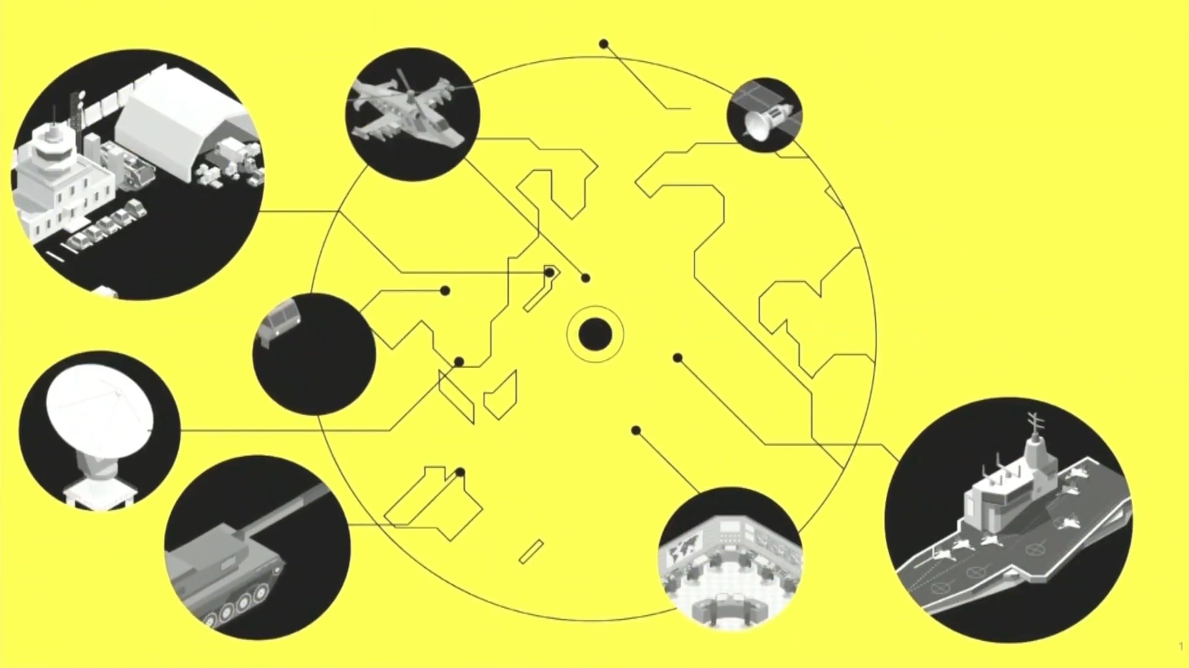
Examples of Edge Computing!
o Microsoft
o Google
o Netflix
o Smart Watches
o Alexa
o ATM Security
o Smart/ Automatic Cars

Slide 6
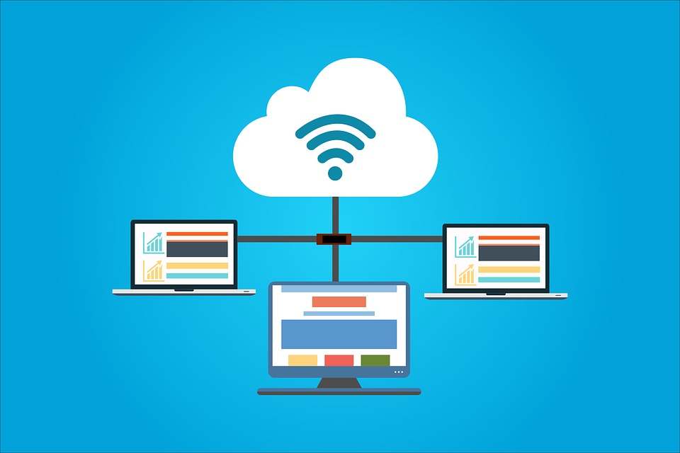
Why Edge Computing?
Edge computing is now used by big Tech Giants and IOT products due to their fast real time processing & less dependency on Cloud/ Server..
Even if there is poor internet connectivity, Edge computing provides assured quality.
In IOT devices, it helps in taking fast decisions without relying on server & fills the communication Gap like this.

Slide 7

How can use React JS or Next JS for it?
Now we can use React JS 18 or Next JS 13 for the purpose as they offer Server Side Components. They allow the developer to build applications that span server and the client, along with providing rich interactivity of client side applications with improved performance of traditional server rendering.

Slide 8
Thank You!
By, Zain Ul Abideen Baloch

